Slide 1
Progressive Return to Activity Following Acute Concussion/Mild Traumatic Brain Injury Date Time
Traumatic Brain Injury Center of Excellence
1

Slide 2
Presenters
Insert picture
Insert picture
Name, credentials
Discipline
Affiliation
Name, credentials
Discipline
Affiliation

Slide 3
Disclaimer
The views expressed in this presentation are those of the authors and do not necessarily represent the official policy or position of the Defense Health Agency, Department of Defense, or any other U.S. government agency. This work was prepared under Contract HT0014-19-C-0004 with DHA Contracting Office (CO-NCR) HT0014 and, therefore, is defined as U.S. Government work under Title 17 U.S.C.§101. Per Title 17 U.S.C.§105, copyright protection is not available for any work of the U.S. Government. Oral presentation at the ~~Event Name, Month, Year~~. For more information, please contact dha.TBICOEinfo@mail.mil.

Slide 4
Acronyms Table
Acronym
AFSC | Air Force Specialty Code
AIM | Alternate Input Method
ASD | Acute Stress Disorder
CNS | Central Nervous System
CT | Computed Tomography
DoDI | Department of Defense Instruction
GAD-7 | General Anxiety Disorder-7
MACE 2 | Military Acute Concussion Evaluation 2
mTBI | Mild Traumatic Brain Injury
NSAIDS | Nonsteroidal Anti-Inflammatory Drugs
PCM | Primary Care Manager
PRA | Progressive Return to Activity
RTD | Return to Duty
SM | Service Member
TSWF | Tri-Service Workflow
VOMS | Vestibular Oculomotor Screening
Acronym
AHLTA | Armed Forces Health Longitudinal Application
ANAM | Automated Neuropsychological Assessment Metrics
CMT | Concussion Management Tool
CPG | Clinical Practice Guideline
DOD | Department of Defense
EHR | Electronic Health Record
HIT-6 | Headache Impact Test-6
MOS | Military Occupational Specialty
NEC | Navy Enlisted Classification
NSI | Neurobehavioral Symptom Inventory
PHQ-9 | Patient Health Questionnaire-9
PTSD | Post-Traumatic Stress Disorder
SIQ | Sick in Quarters
TBICoE | Traumatic Brain Injury Center of Excellence
VA | Veterans Affairs

Slide 5
Learning Objectives
Identify the key changes to the updated 2021 Progressive Return to Activity (PRA) Clinical Recommendation
Explain the rationale for using a PRA protocol for service members (SMs) post-concussion
Understand the criteria for progression following a concussion or mild traumatic brain injury (mTBI)
Identify appropriate activities at each stage of progression
Understand how to apply primary care management strategies and specialty referral considerations to treat concussed SMs who are not progressing as expected
Utilize the Tri-Service Workflow (TSWF) mTBI Alternate Input Method (AIM) Form to document the PRA in the Armed Forces Health Longitudinal Application (AHLTA)

Slide 6
The PRA Algorithm
The PRA also includes a link to frequently asked questions to help clarify common scenarios encountered by providers during the PRA process.
Notes:
It is recommended that the presenter briefly demonstrates the interactivity of the PRA CR. It is best practice to download the CR from www.health.mil/TBIProviders or double click on “PRA Clinical Recommendation” in this slide, before the presentation. They can also recommend that the audience has the algorithm to refer to throughout the presentation. If the presenter is in a location with limited internet access, they can also download any other references they wish to refer to, such as the patient fact sheets.

Slide 7
Navigating the PRA Algorithm
Clicking the blue links within the algorithm will send you to more detailed guidance within the PRA, or will download additional resources.
Notes:
The algorithm provides overall guidance for the provider.
The red-lettered superscripts are for readers to navigate a printed copy of the algorithm.

Slide 8
What is the Progressive Return to Activity (PRA)?
Similar to a “return to play” or “return to learn” process
A step-wise, evidence-based protocol designed to return SMs to full duty as quickly and safely as possible after a concussion
Should be used for all SMs diagnosed with a concussion, whether they’re deployed or in garrison
Using the PRA, the earliest a SM can be returned to full duty after a concussion is seven days
Comprised of 6 stages with each stage introducing increasing demands on both the physical/vestibular and the cognitive/oculomotor systems
Progression is based on subjective and objective assessment of symptoms, as patients advance from relative rest to returning to full duty
Notes:
Presenter can inform the audience to refer to the references in the CR for more information on the articles that were used to develop the PRA

Slide 9
Key Changes 1-2
Simplified Clinical Suite
PRA for Primary Care Managers (PCMs), PRA for Rehabilitation Providers, the Concussion Management Tool (CMT) and all their accompanying materials, have been combined into a single clinical recommendation.
Allows for a smooth transition from performing the Military Acute Concussion Evaluation 2 (MACE 2) at the point of injury to using the PRA to manage concussion across the continuum of care.
2. Updated Instructions for Progression
Previously, the Neurobehavioral Symptom Inventory (NSI), a 22-item validated tool of common mTBI symptoms, was completed daily by the SM.
Now the SM will complete a self-evaluation each morning indicating whether they feel the same, better or worse than the previous day and the NSI will only be completed at follow-up visits with their PCM.
Notes:
There is an FAQ on why the guidance has been changed about the NSI as criteria for progression.

Slide 10
Key Changes 3-4
3. Updated the Definition of Rest to Relative Rest
Previously, complete rest, sometimes called cocooning, was prescribed for acute concussion.
Now there is mounting evidence that prolonged strict physical and cognitive rest can actually prolong the recovery process, whereas promoting early activity can expedite recovery.
4. Clarified Activity Recommendations and Simplified Restrictions in Each Stage
Activity restrictions and recommendations are now more relevant to SMs.

Slide 11
Key Changes 5-6
6. Clarified and Expanded the Return to Duty (RTD) Screening
Previously, SMs only had to pass an exertional test to return to full duty.
Now, the SM must pass both a physical screening with an exertional test and a cognitive screening using the Automated Neuropsychological Assessment Metric (ANAM).
5. Included and Updated Symptom-Guided Management Strategies and the Specialty Referral Guidance
The symptom clusters, previously included in the CMT, have been updated to provide PCMs with treatment options and specialty referral guidance for various post-concussive symptoms.
Notes:
The FAQ provides answers to these changes.

Slide 12
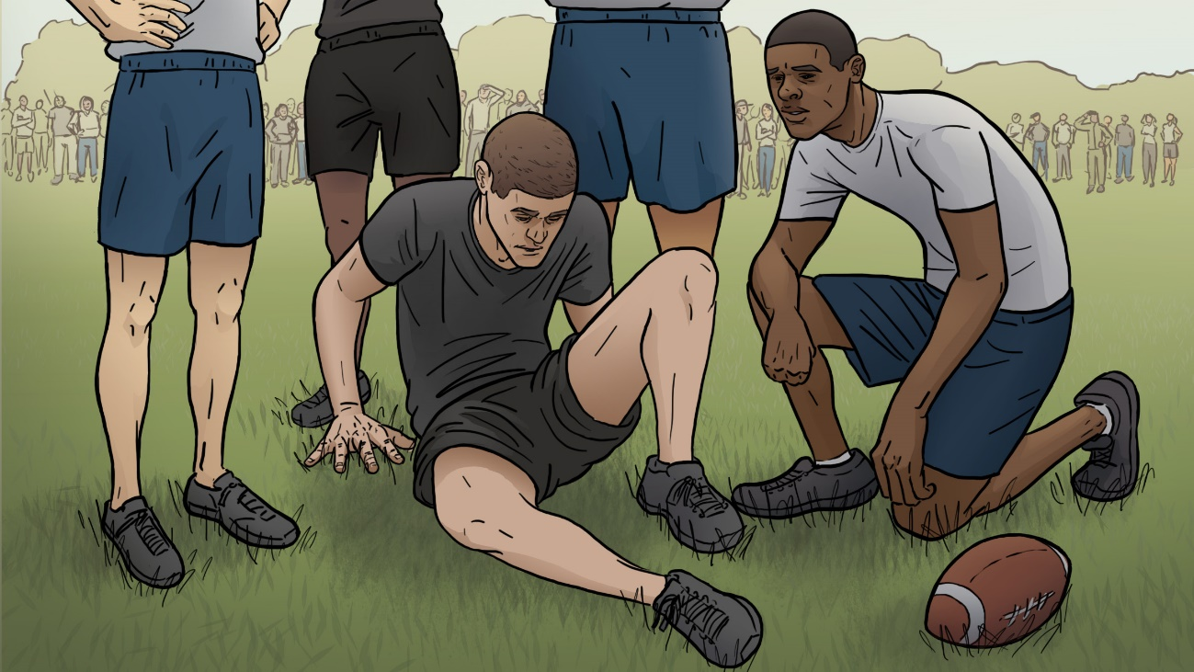
Clinical Case Study #1
Scenario
You are seeing sick call on a Thursday morning when you notice a walk-in appointment is scheduled for a 23-year-old SM.
Upon interviewing SM Rogers, he states that he was playing touch football that morning with his unit when he hit his head on the ground. He states he felt “dazed” and “saw stars” for approximately 30 seconds and then had a mild headache. One of his buddies who was playing football with him said he was conscious the entire time, and that he walked off the field with no difficulty.
It’s two hours since the injury, and he complains of a mild headache, slight dizziness and very mild nausea. You perform a MACE 2 exam and he screens positive for concussion, with a normal neurologic examination.
What initial concussion management do you provide for SM Rogers?

Slide 13
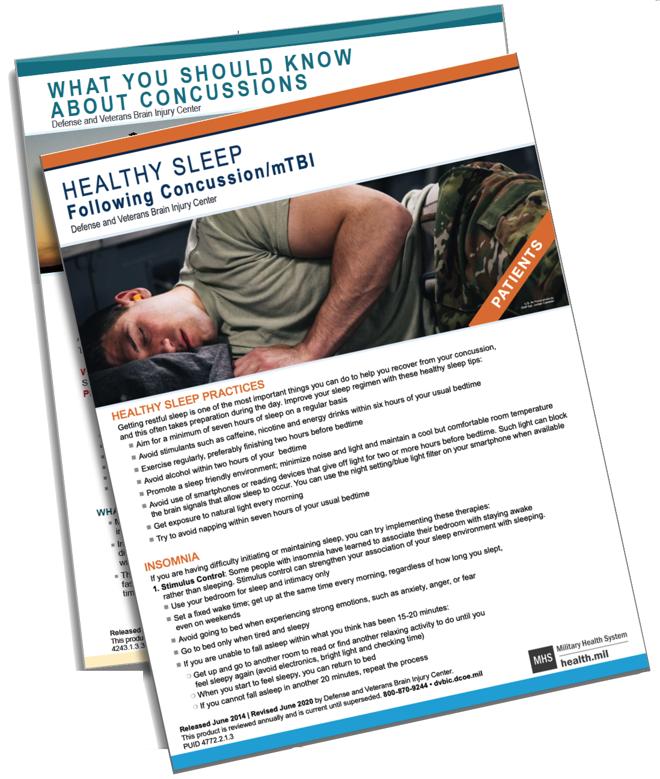
Clinical Case Study #1: Initial Concussion Management
May be performed by first responder/medic/corpsman, emergency department provider, or PCM.
Provide concussion education and set expectations for full recovery
Manage acute headaches
Review current medications and supplements
Initiate 24-hour SIQ/Quarters
Ensure a follow-up visit is scheduled with the SM's PCM in 24 hours
Notes:
Presenter can inform the audience that specific recommendations for concussion education and headache treatment are included in the CR
Here is the link for:
https://health.mil/Reference-Center/Fact-Sheets/2020/07/30/Headaches-Following-ConcussionmTBI-Fact-Sheet
Here is the link for:
https://health.mil/Reference-Center/Fact-Sheets/2020/07/30/Healthy-Sleep-Following-Concussion-mTBI-Fact-Sheet

Slide 14
Clinical Case Study #1: Initial Follow-up Visit
SM Rogers returns 24 hours later for his initial concussion follow-up. He continues to complain of a 2/10 headache, mild nausea and very slight dizziness. You perform a physical exam, and the results are unremarkable.
What do you do next?
Perform an initial NSI and consider repeating the MACE 2
Initiate PRA Stage 1: Relative Rest
Review the Instructions for Progression
Provide the PRA Patient and Leadership Guide (PLG) and initiate Duty Modifications
Provide Follow-up Guidance

Slide 15
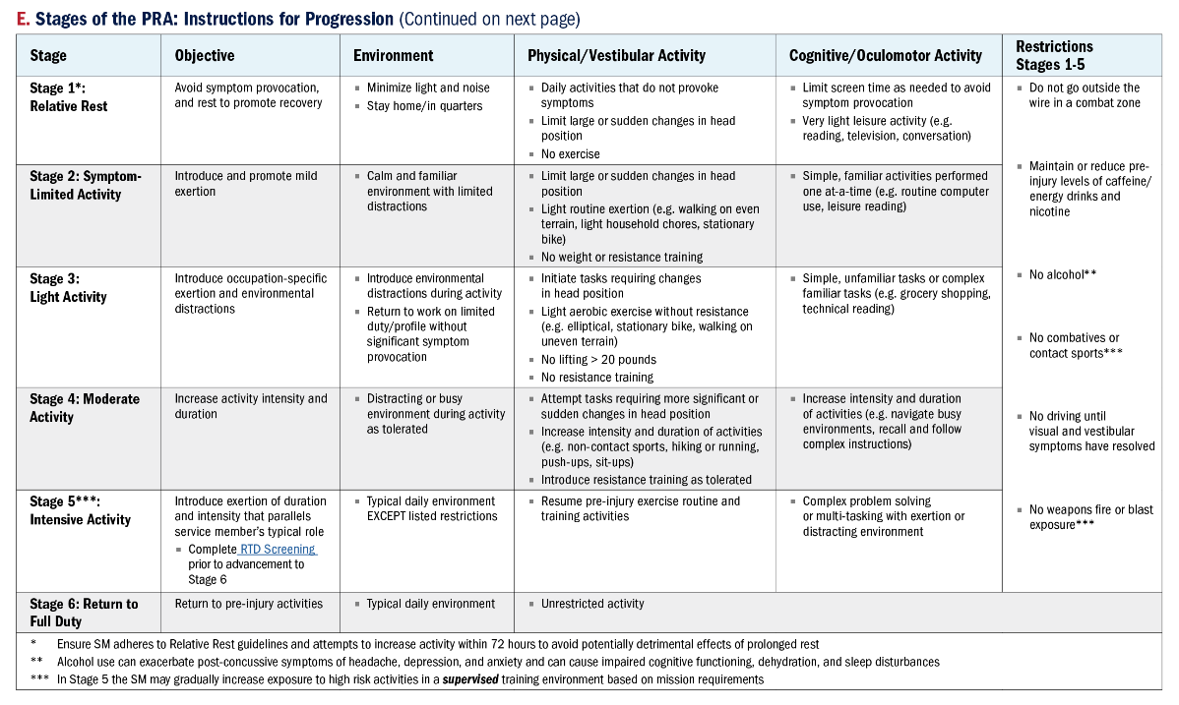
Clinical Case Study #1: What are the PRA Stages?
It is recommended that you have the PRA Stages table with you throughout the presentation. For specific activity recommendations please refer to the table.
Stages of the PRA and objectives:
Stage 1 Relative Rest: Avoid symptom provocation, and rest to promote recovery.
Stage 2 Symptom-Limited Activity: Introduce and promote mild exertion.
Stage 3 Light Activity: Introduce occupation-specific exertion and environmental distractions.
Stage 4 Moderate Activity: Increase activity intensity and duration.
Stage 5 Intensive Activity: Introduce physical and cognitive activities of duration and intensity that parallel the SMs typical role.
Stage 6 Return to Full Duty: Return to all pre-injury activities.
Each table row shows the PRA stage and the columns show the stage’s objective, environment, physical/vestibular activities, cognitive/oculomotor activities, and restrictions.
Notes:
Presenter can provide some examples of activities SMs can perform in each stage.

Slide 16
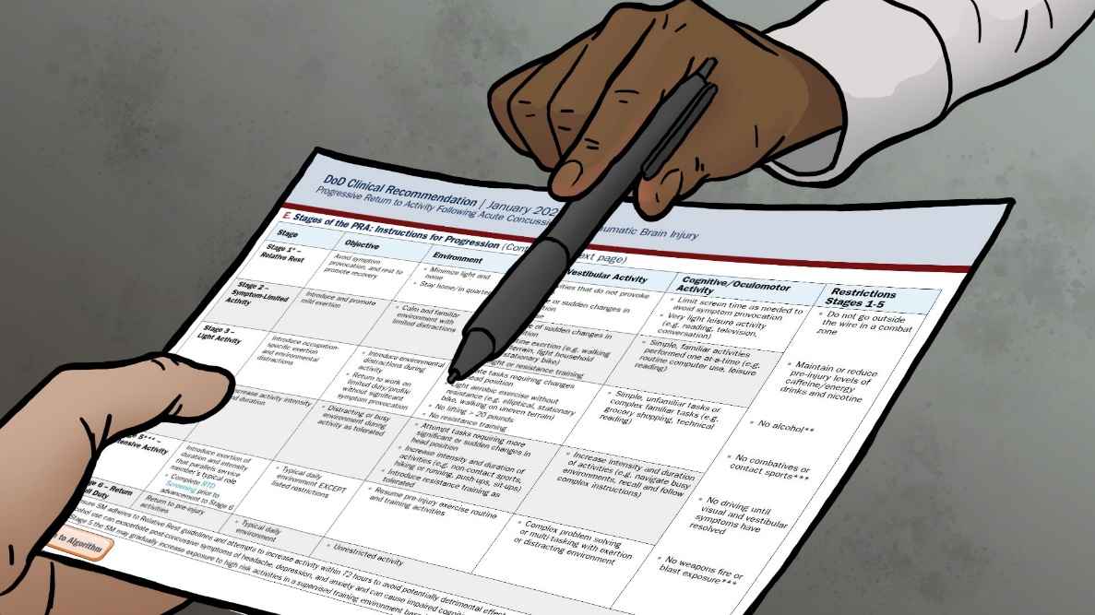
Clinical Case Study #1: What are the Instructions for PRA Stage Progression?
Before progressing, a SM must spend at least 24 hours in each stage.
At the beginning of each day, the SM should self-evaluate their symptoms by simply asking themselves how they are feeling compared to the previous day:
If symptoms are the same or better AND they have no new symptoms → they can move on to the next stage
If symptoms are worse OR they have new symptoms → they remain at the current stage for an additional 24 hours
If symptoms worsen during an activity, the SM should follow the guidelines for Stage 1, Relative Rest, until the exacerbation resolves, and then return to the previously tolerated stage for the remainder of the day.
The next day, if the SM is feeling the same or better, they can attempt the next stage activities.

Slide 17
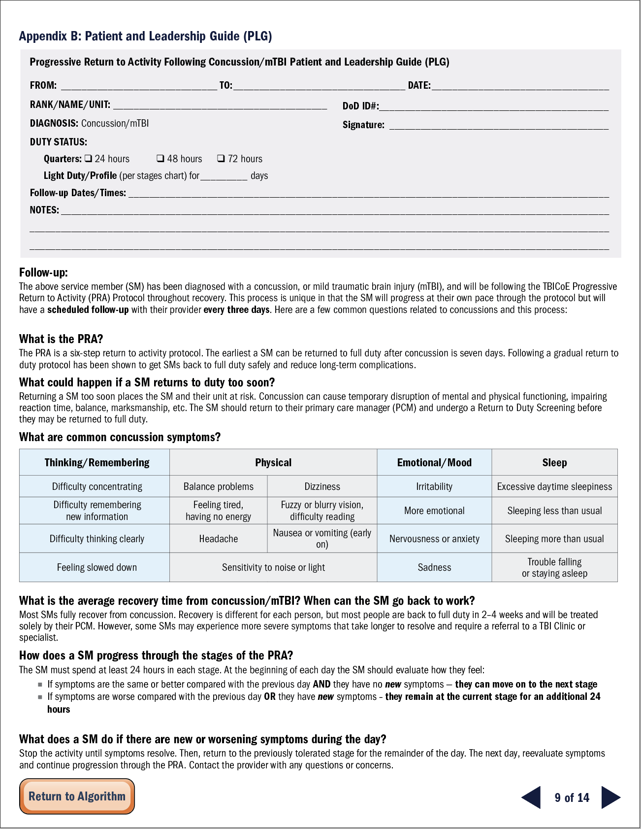
Clinical Case Study #1: What is the Patient and Leadership Guide?
The PLG is a concise document that provides an overview of the PRA protocol and answers common questions that command leadership may have, including any duty modifications.
Outlines activities that the SM should and should not perform for each stage of the PRA.
The PCM should ensure that the PLG is given to every SM with a concussion and communicated with their chain of command.
Policies and procedures are service and command specific:
Consult duty and deployment standards for your organization when dispositioning patient.
Specific restrictions based on the patient’s MOS/NEC/AFSC, individual injury characteristics, or any other factors should be annotated on the chit/profile as well as any reasons for lack of adherence to uniform standards.

Slide 18
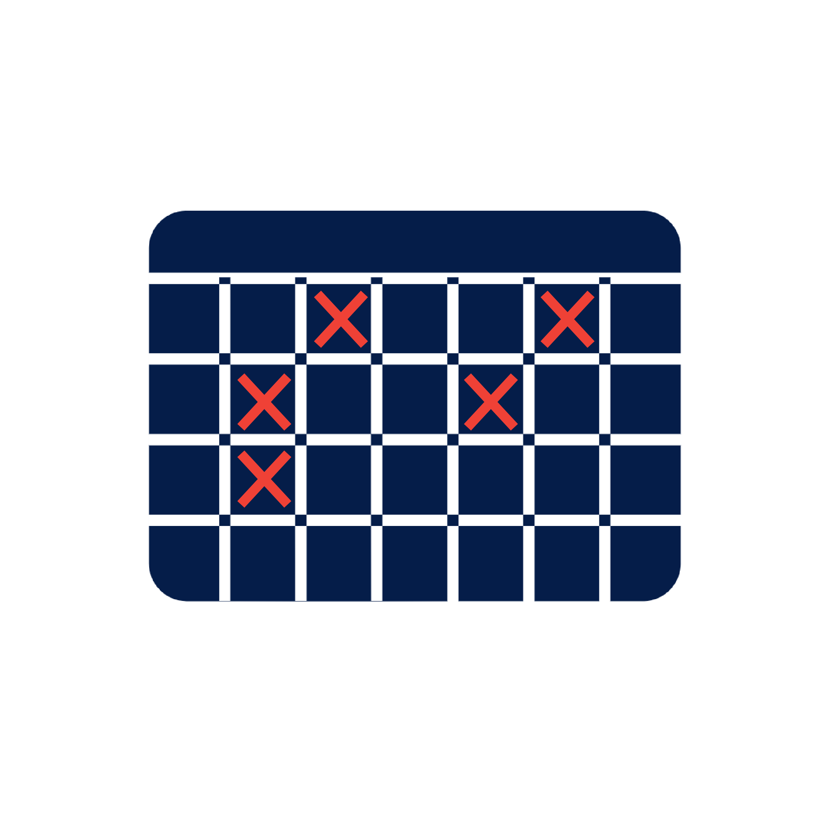
Clinical Case Study #1: What is the Follow-up Guidance?
Instruct the SM to schedule a follow-up appointment every 3 days or sooner if symptoms acutely worsen.
Intent of close follow up is to ensure SM is progressing in their recovery.
Recommend scheduling 5 follow up visits during the first appointment to ensure access to care and to allow SMs to provide appointment dates to their chain of command for planning purposes.
Consider virtual, telephone, or clinical support staff follow-ups if clinically appropriate and feasible in your practice setting.
S │ M │ T │ W │ T │ F │ S

Slide 19
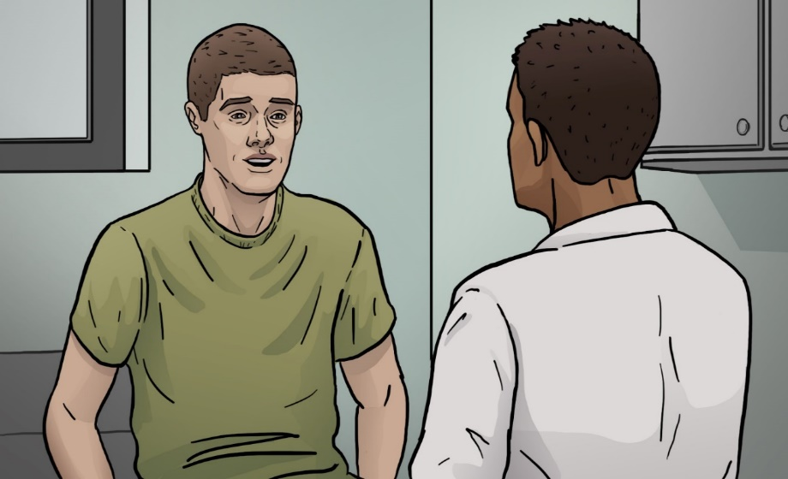
Clinical Case Study #1: Subsequent Follow-up Visits
SM Rogers has been returning to the clinic every three days as instructed, and has been progressing through the PRA stages without any new symptoms. He has returned to his usual exercise routine and “feels great.” He presents to you in clinic for a scheduled follow up and states that he is currently in stage five (intensive activity) and has been so for the past 24 hours.
What do you do next?
1. Perform and review NSI 2. Perform RTD screening

Slide 20
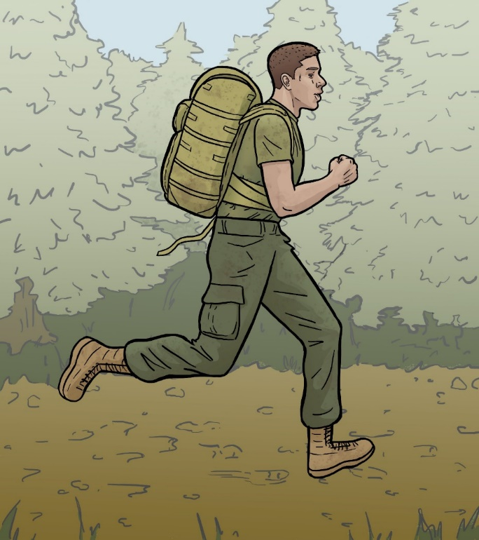
Clinical Case Study #1: What is the Return to Duty Screening?
Composed of both a physical and cognitive component; SM must pass physical test before taking cognitive test.
Required before returning a SM to full duty to objectively measure mission readiness.
Only performed after the SM has spent a minimum of 24 hours in Stage 5 without any new or worsening symptoms.
May be used in conjunction with a patient’s subjective history of tolerated physical and cognitive activities.
Consider MOS/NEC/AFSC-service specific return to duty requirements (e.g., flight status, dive status, jump status, etc.) prior to having the SM perform the RTD.

Slide 21
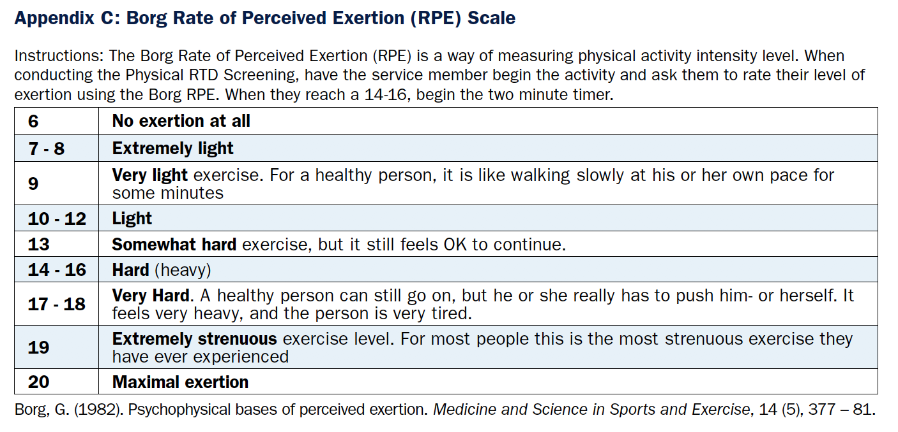
Clinical Case Study #1: What is the Physical RTD Screening?
Physical exertion testing may be done in office, gym, or physical training area.
Have the SM perform 2 minutes of supervised aerobic activities at an exertion rate of 16 or greater on the Borg Rate of Perceived Exertion (RPE).
Scale that helps estimate how hard someone is exercising.
Can estimate the SM’s actual heart rate by multiplying the Borg RPE number by 10.
Before you can start the 2-minute timer, the SM must report a 16 or greater on the Borg RPE, which may take several minutes.
Borg Rate of Perceived Exertion (RPE) Scale

Slide 22
Clinical Case Study #1: What is the Physical RTD Screening? Cont.
Preferred activities include those that stress the vestibular system such as modified burpees, sit-ups, or jumping jacks—other activities may include high-knees, step-ups, push-ups, running, elliptical, or exercise bike.
During exertion, observe SM for overt symptom provocation→ If no symptoms are present, SM can proceed to RTD cognitive screening.
If symptoms are present → Use the Symptom Guided Management and re-test in 48–72 hours.

Slide 23
Clinical Case Study #1: What is the Cognitive RTD Screening?
The preferred neurocognitive screening is the ANAM.
The ANAM has been added to the 2021 PRA and should only be performed after the SM has successfully completed the physical portion of the RTD screening.
If the SM completes the physical and cognitive screenings without symptom provocation, they can progress to stage 6 and return to full duty.
Ordering the ANAM is simple and available at most Military Treatment Facilities.
How to Request ANAM
Call ANAM Help Desk
Phone number: 1-855-630-7849 (toll free)
Hours of Operation: 24 hours, 365 days
Send a request to ANAM Results Request Inbox (cannot be encrypted): usarmy.jbsa.medcom.mbx.otsg--anam-baselines@mail.mil
Congratulations on returning SM Rogers to full duty!
Notes:
Presenter can inform the audience that if the ANAM is unavailable due to deployment or location in an austere environment, they may repeat the Cognitive Exam portion of the MACE 2 (Questions 5–16). However, this should be de-emphasized as evidence shows that the ANAM is a superior neurocognitive assessment.

Slide 24
Clinical Case Study #2: Scenario
Let’s return to SM Rogers. Instead of progressing through the PRA stages without symptoms, let’s assume he actually complains of a worsening headache and dizziness anytime he goes for a run. When seeing you in clinic, he states that he completed stage 3 without any significant problems but has been unable to progress from stage 4 for the past 3 days.
What do you do next?

Slide 25
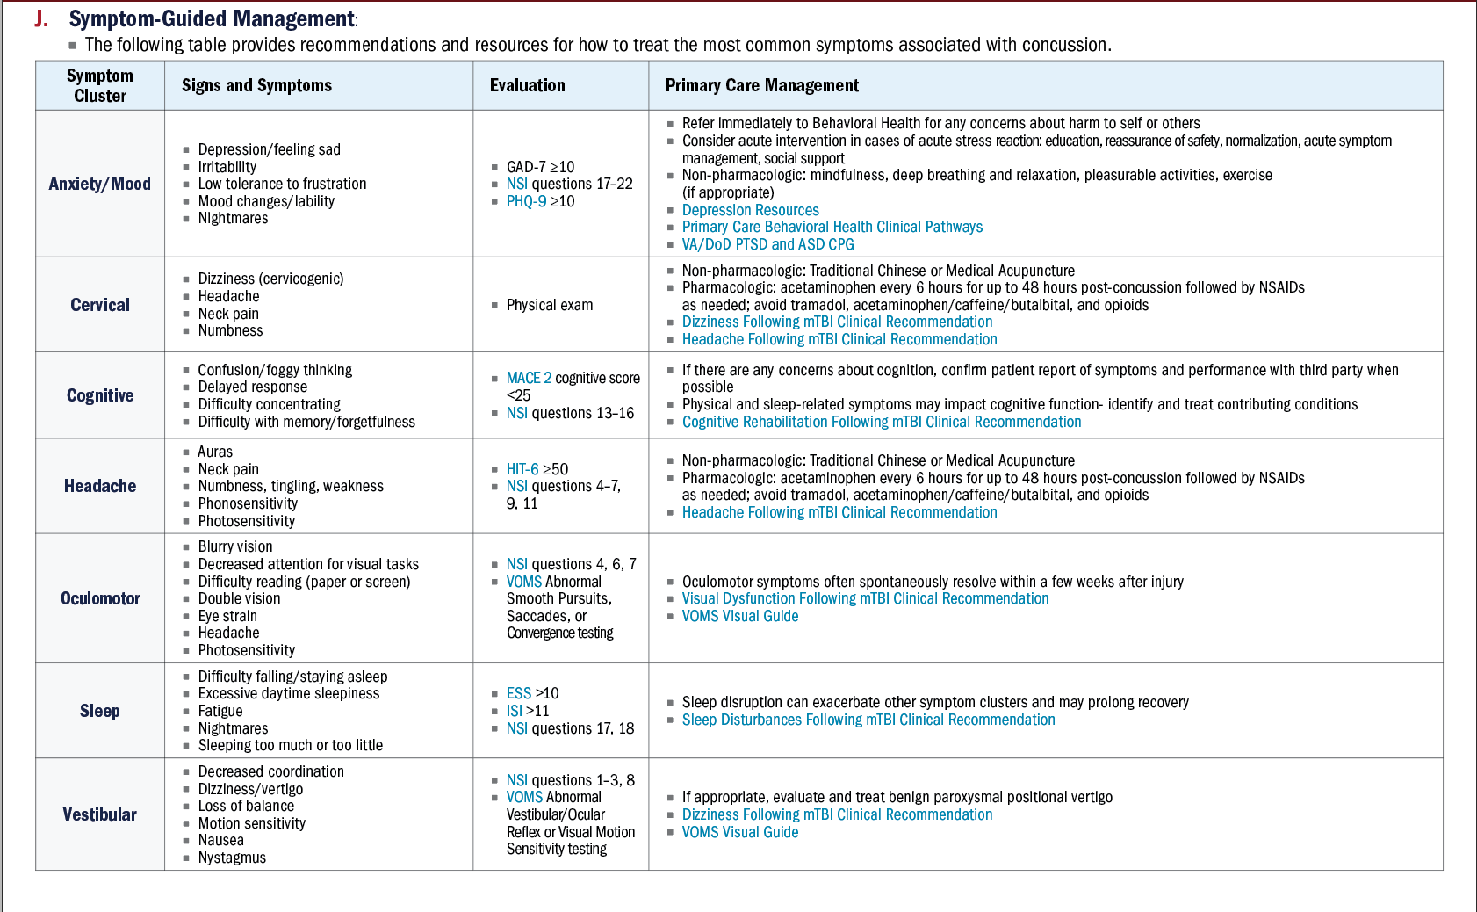
Clinical Case Study #2: What is Symptom-Guided Management?
Describes primary care management strategies that can be used to assist SMs who are not progressing as expected through the PRA.
Table is divided into signs and symptoms, evaluation tools and primary care management strategies for the most common symptom clusters associated with concussion.

Slide 26
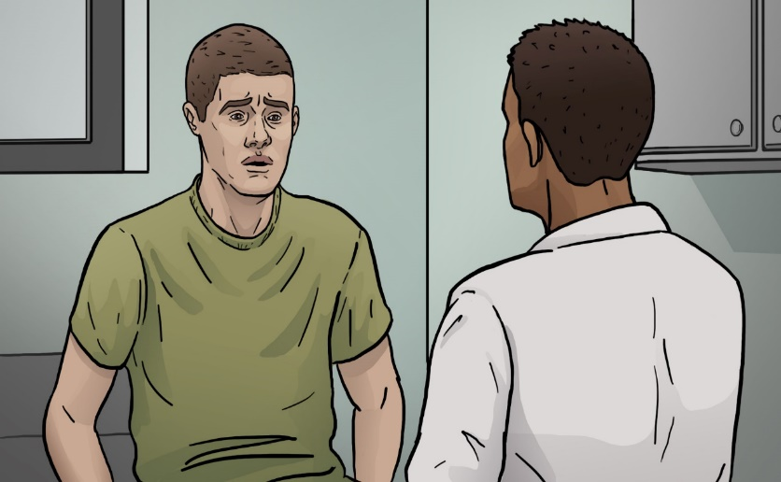
Clinical Case Study #2: Follow-up Visit
SM Rogers returns to see you in clinic. Although he has been following up with you regularly and has implemented the non-pharmacologic therapies as well as taking the NSAIDS you recommended, he reports no improvement in his headaches. You look through his record and realize that he has remained in stage 4 for the past 15 days.
What do you do next?
Refer SM Rogers to a concussion care or TBI clinic. If not available, refer him to an appropriate specialty provider using the Specialty Referral Guidance table. Since SM Rogers is primarily complaining of persistent headaches, you would ask him further questions to assess if neurology, neuro-optometry or physical medicine and rehabilitation (PM&R) would be the most appropriate referral.

Slide 27
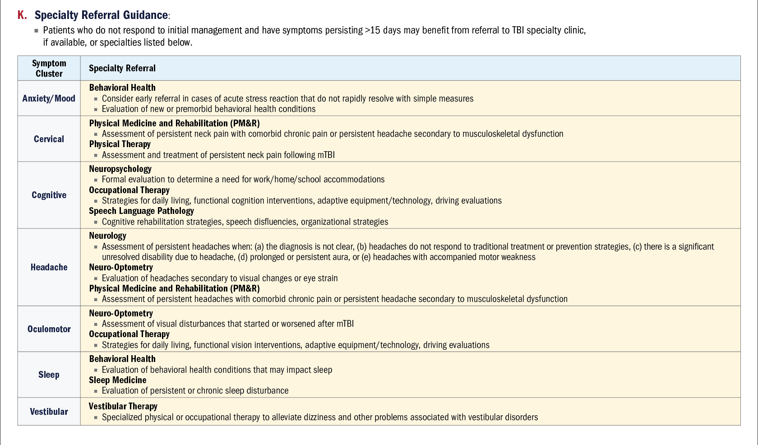
Clinical Case Study #2: What is the Specialty Referral Guidance?
Provides recommendations for referral to a higher level of care if a SM is not responding to initial management or if symptoms persist for longer than 15 days.
Use in conjunction with your clinical judgment and the resources available at your Medical Treatment Facility.

Slide 28
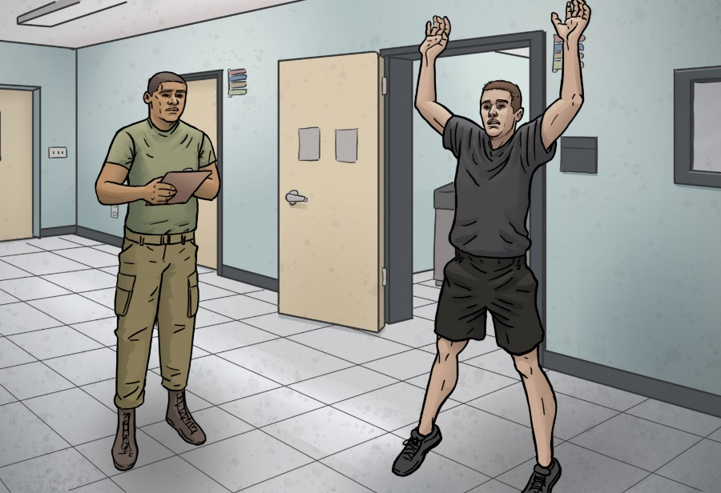
Clinical Case Study #3: Scenario
Let’s return to SM Rogers. Instead of completing the RTD screening and returning to full duty as he did in clinical case scenario #1, lets assume that while performing jumping-jacks during the physical exertion test, you notice that he grimaces and places his hand on his head as if he has a headache.
What five things should you do next?
Stop the test
Have SM remain in Stage 5 and re-test in 48–72 hours as appropriate
Refer to the Symptom-Guided Management while awaiting re-test
If the re-test is abnormal, refer to a higher level of care based on the Specialty Referral Guidance
Provide Follow-up Guidance

Slide 29
Special Clinical Considerations
Must be referred for a Recurrent Concussion Evaluation
Continue PRA protocol while awaiting specialty appointment
SM must stop progression at Stage 5 and can only be returned to full duty (Stage 6) by a specialist and not by PCM
A SM who has sustained 3 or more concussions in the past 12 months
A SM who delays in presenting to his PCM after a potentially concussive event
Consider performing the initial evaluation including the MACE 2
Have the SM enter the PRA, however, rather than beginning at Stage 1, evaluate at which stage is most appropriate based on the timeframe since the injury and the SM’s activity level and symptoms
A deployed SM who has experienced two concussions in the past 12 months
Per DoDI 6490.11, they must spend a minimum of seven days in the PRA protocol prior to returning to full duty
Notes:
Presenter can inform the audience that there is a Recurrent Concussion Evaluation card which states that a SM who has sustained 3 or more concussions in the past twelve months can only be returned to duty by a specialist.

Slide 30
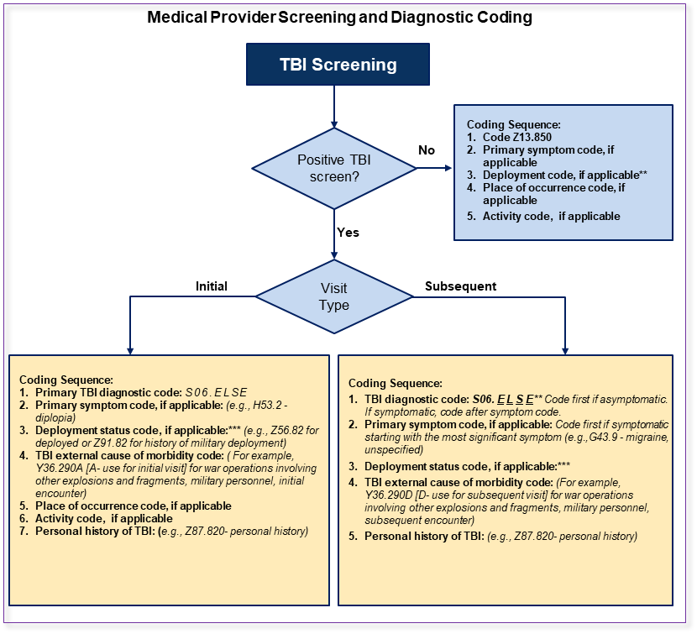
mTBI Coding
Accurate coding is important for:
Surveillance
Continuity of Care
Reimbursement for care
Disability determination
Identification of trends
Improvement in patient outcomes
mTBI 72-hour follow up required after initial visit S06.ELS “E”
A = initial visit
D = subsequent/follow-up visit
S = sequela

Slide 31
mTBI TSWF AIM Form
The PRA should be documented in the TSWF mTBI form located in AHLTA*
*For AHLTA users only. Please check back for details on MHS Genesis
Consider adding both the TSWF Navigator and the TSWF mTBI form to your favorites

Slide 32
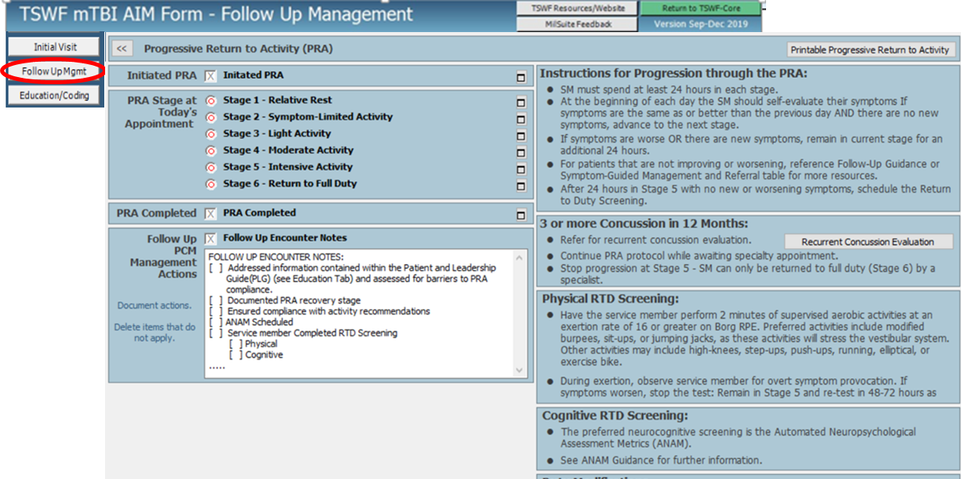
PRA on TSWF mTBI AIM Form
Please note the TSWF mTBI AIM Form is undergoing revisions to incorporate updates to the PRA
The PRA is located in the “Follow Up Mgmt” Tab of the TSWF mTBI AIM form

Slide 33
Key Takeaways
All SMs diagnosed with a concussion should follow the PRA protocol, whether they are symptomatic or not.
The PRA is a patient self-guided, evidence-based, six-step return to activity protocol.
Following a gradual return to duty protocol has been shown to return SMs back to full duty safely and reduce any long-term complications.
Recovery is different for each person, but most SMs are back to full duty within 2–4 weeks post-injury.
Some SMs may experience more persistent symptoms and would be better managed by a TBI Clinic or specialist.
A SM is required to pass a RTD screening before they return to full duty.
The PRA helps promote standardization of evidence-based concussion care across the Military Health System
Accurate coding and utilization of the mTBI TSWF form is essential for continuity of care

Slide 34
Questions

Slide 35
Contact
Insert presenters contact information
www.health.mil/TBICoE
Email: dha.tbicoeinfo@mail.mil
That concludes this training.
Thank you for your attention!

Slide 36
Acknowledgements and References
All illustrations created by Kori Zick (TBICoE)
References
Bailie JM, Remigio-Baker RA, Cole WR, et al. Use of the Progressive Return to Activity Guidelines May Expedite Symptom Resolution After Concussion for Active Duty Military. Am J Sports Med. 2019;47(14):3505-3513.
McCrory P, Meeuwisse W, Dvorak J, et al. Consensus statement on concussion in sport—the 5th international conference on concussion in sport held in Berlin, October 2016. Br J Sports Med. 2017;51(11): 838-847.
Porter SJ, Johnson DE. Clinical Use of the Automated Neuropsychological Assessment Metrics TBI-Mil Expanded Battery in Evaluating Concussion Recovery: A Retrospective Study. Mil Med. 2020;185(9-10):e1722-e1727. doi:10.1093/milmed/usaa075.
Traumatic Brain Injury Center of Excellence (TBICoE). Progressive Return to Activity Following Acute Concussion/Mild Traumatic Brain Injury. 2021. https://health.mil/About-MHS/OASDHA/Defense-Health-Agency/Research-and-Development/Traumatic-Brain-Injury-Center-of-Excellence/Provider-Resources
Valovich McLeod TC, Lewis Joy H, Whelihan Kate, et al. Rest and Return to Activity After Sport-Related Concussion: A Systematic Review of the Literature.J Athl Train. 2017;52(3): 262–287. https://doi.org/10.4085/1052-6050-51.6.06

